Slide 1
Data Governance Strategies: Ensuring Quality, Consistency, and Trust in your Data
Rohin Bansal
Director, Data Governance & Enablement
TELUS Data & Trust Office
CDAO Canada: March 26, 2025

Slide 2

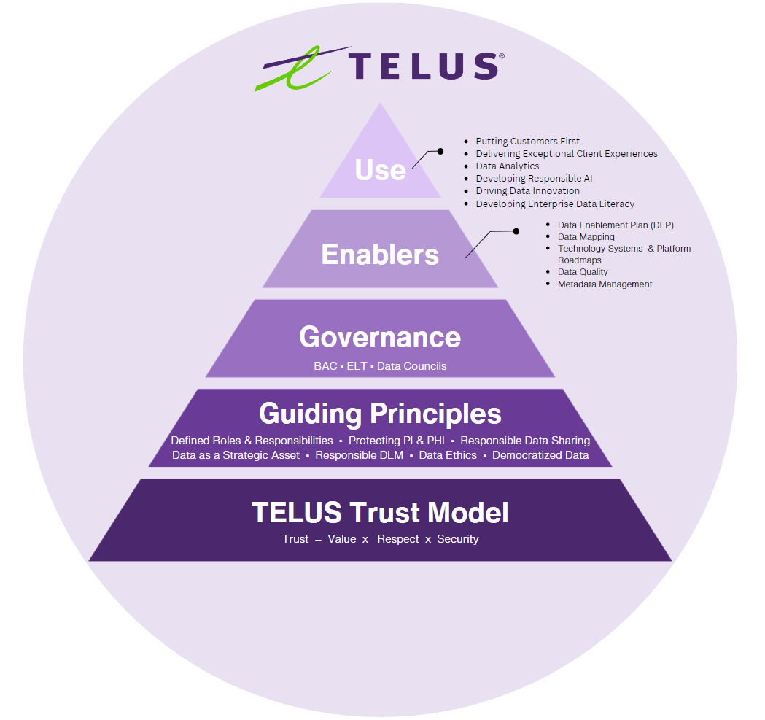
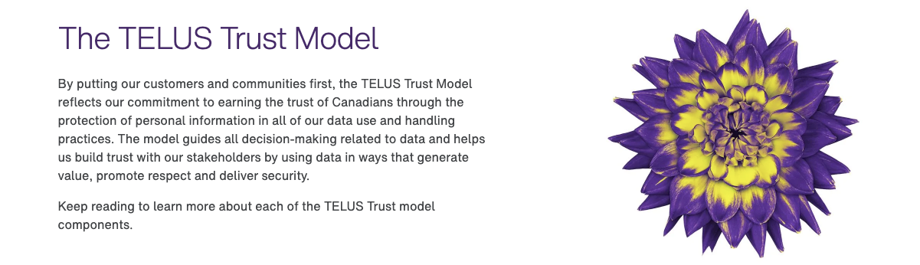
We build trust with our stakeholders by using data in ways that generate value, promote respect, and deliver security.
Notes:
Ojas: You had an important announcement in October. Why did TELUS invest in this effort?
Rohan describes why TELUS did it

Slide 3

Important Roles & Responsibilities
Business Data
Stewards
Data Governance
Data & Trust Office
Corporate Security
Team
Metadata Stewards
Team Members

Slide 4
Data Stewardship at TELUS
We have 588 Data Stewards throughout TELUS, who are trained in the following areas:
Data Governance
Data Lifecycle
Management
TELUS
Data
Stewardship Program
Data Privacy
Data Security
Empowering team members with knowledge to encourage thought leadership and more opportunities to leverage data respectfully, serving as the foundation of our data-driven transformation.

Slide 5

Notes:
https://www.youtube.com/watch?v=qFHHFUffp8o

Slide 6
Developing Frameworks, Policies, Standards
Data Lifecycle Management Policy
Data Governance Framework
Metadata Management Standard
Data Quality Standard
Data Lifecycle Management Systems Standard
Cloud Data Governance Standard

Slide 7
Designing Processes & Best Practices
“Data Enablement Plan”
“Impact Assessment”

Slide 8
Evolution through Engagement
Flexibility as Strength
Trust is your foundation

Slide 9
Data Governance isn’t
“one-size-fits-all”

Slide 10
telus.com/trust

