Slide 1
AI @ HP: Transforming the future of work
Scott Hallworth
Chief Data & Analytics Officer and Head of Digital Solutions

Slide 2
AI Internal Strategy &
Adoption
Key Takeaways
HP is actively embedding AI into internal operations and end-to-end processes to redefine its ways of working.
AI/ML is a key enabler to unlocking Digital Capabilities and requires a strong end-to-end program and foundation to build on
HP is following a multi-tiered and holistic approach anchored on a solid foundation for its AI transformation:
  Focusing on high value impact process transformations: Software generation, chat bots for agents and customers and Marketing content generation
  Working proactively a large use case funnel Pan-HP across the value chain
  Embedding AI into tools and processes and upskilling talent
  Providing a robust technical and data foundation
In parallel, we are using AI internally and are HP’s AI products as “Customer Zero”.

Slide 3

AI @ HP: Transforming the future of work
Creating
Efficiencies
Enabling
Deeper Insights
Developing
Recommenders
Prioritizing
Managing Risk

Slide 4
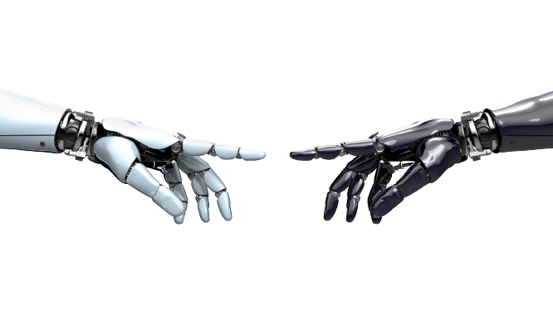
AI is not new, but is rapidly evolving
ARTIFICIAL INTELLIGENCE
Early artificial intelligence stirs excitement.
MACHINE LEARNING
Machine learning beings to flourish.
DEEP LEARNING
Deep learning breakthroughs drive AI boom.
GENERATIVE AI
GenAI changes
the game.
AGENTIC AI
Agentic AI takes autonomy to a new level.​
1950s
1980s
2020s
Where we are today
2010s
Notes:
To understand ow to use AI, it is important to understand where it came from, and that it is just another statistical model. Reiterate that this isn’t new. Provide quick history lesson of the evolution of AI, with special mention that traditional machine learning is still extremely valuable, and used across the company. Then highlight why generative AI is so exciting and seems so different. Also, mention the fact that we have to custom train it on HP data to get to the right results.

Slide 5

Digital Transformation
Business Value Outcome
AI/ML is a key enabler to unlocking Digital Capabilities
A key dependency on a solid foundation and streamlined end-to-end processes
Efficiencies
Revenue
Experience
AI/ML
Digital Capabilities
Digitally Transform
Analytics & Insights
End-to-end dependencies with a virtuous cycle between Foundation stability and E2E Processes
Intelligent Automation
E2E Processes
Data
Technology
Governance
Foundation
People

Slide 6








Applied AI @ Scale
Applied AI Use Cases
Products & Services
Marketing
Sales
Delivery & Operations
Support & Services
Employee Impact
Cognitive
“How we Think”
Improved Decision Support
Pricing
Optimization
Marketing
Optimization
Business Planning and Forecasting
IR Sentiment
Operational
“How we Execute”
Increased Productivity
Demand Shaping
Software AI Efficiency
Communicative
“How we Engage”
Virtual Assistant
Instant and Connected Knowledge
Proactive
Insights
HP’s focus is higher productivity and impact
Notes:
Take out green

Slide 7




Democratizing AI @ HP
Streamlining employee productivity through commercialized solutions
Enhancing the employee experience by creating tailored experiences
Fostering innovation through new and exciting products
Providing learning opportunities through internal trainings

Slide 8
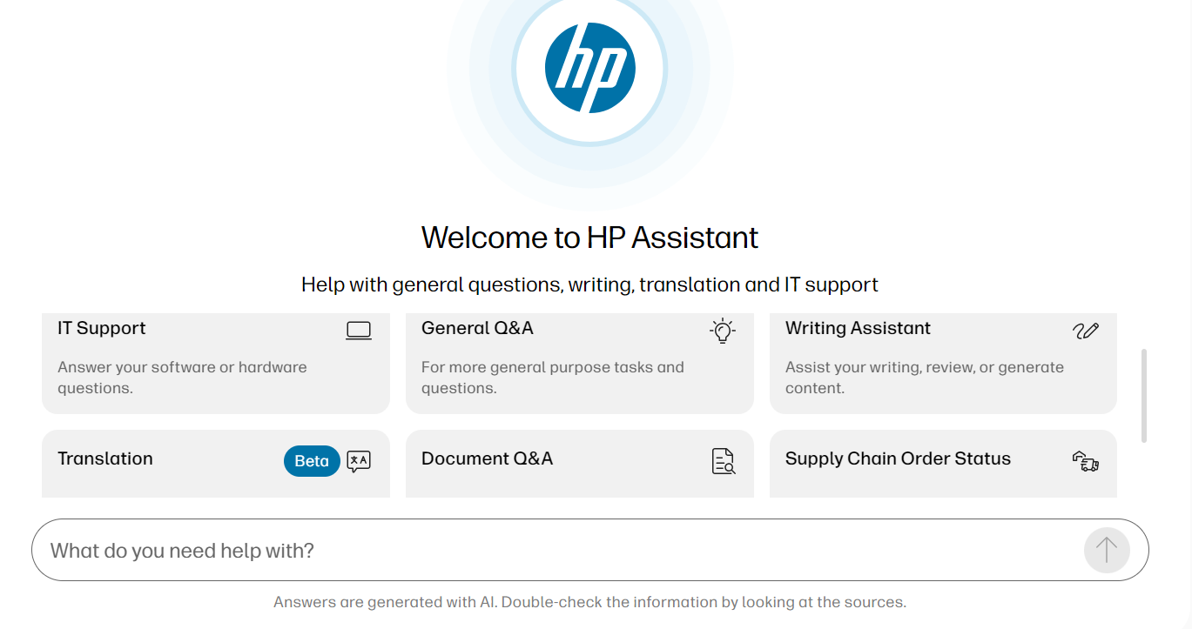




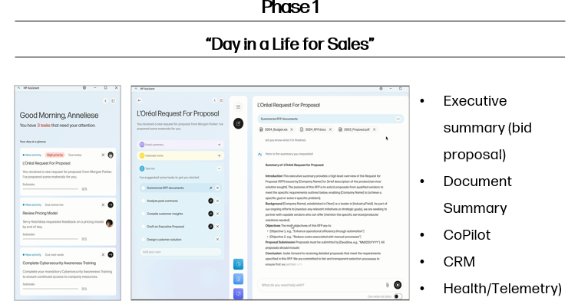

HP Assistant
Personal Productivity
A
General productivity apps Available to all employees
Persona Productivity
B
AI powered problem analysis and solution proposals
Specific to personas
Systems Admin
C
Environment optimization & personalization
Available to all employees

Slide 9

HP Virtual Assistant
A proprietary ChatBot on Services and Products for internal and external users.
Built from >400K documents providing a personalized and seamless search experience
for users.
My Elite laptop does not hold a charge?
There could be a few things causing that, please try the following steps:
  Perform a battery test by…

Slide 10

Investor Relation Sentiment Analysis
Leveraging Virtual Assistant’s Large Language Model (LLM)
HP Chatbot that guides in the preparation of earnings call by providing conversational access to an pre-analyzed database of historical documents on performance and analyst sentiment.

Slide 11


HP is using Z by HP data science solutions
Z by HP data science solutions accelerate data workflows, helping data scientists to be more productive and efficient.
Equipped with rigorous, multi-layered security.
Seamless and highly secure interaction with the cloud—toggle back and forth with ease.
And more…

Slide 12



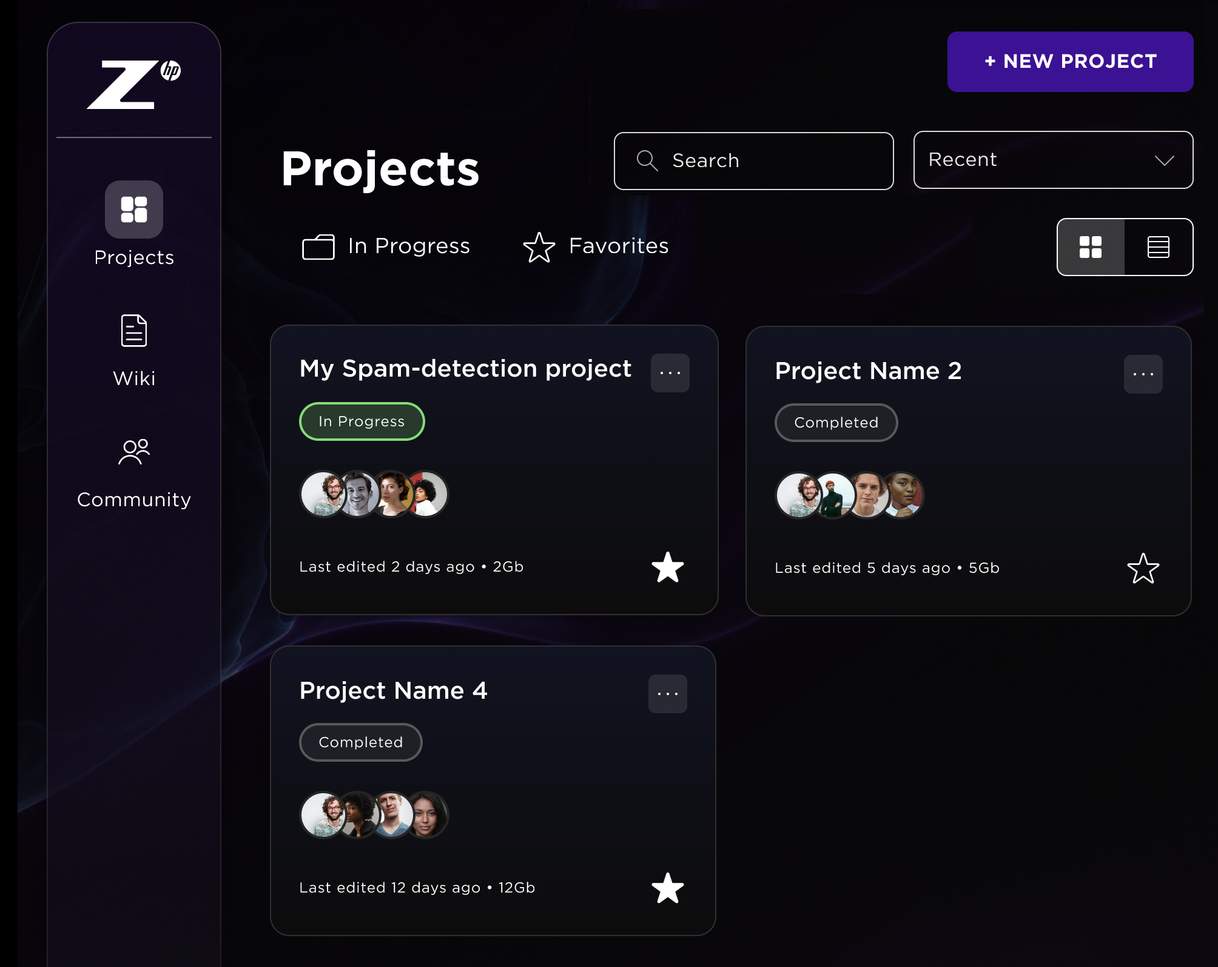
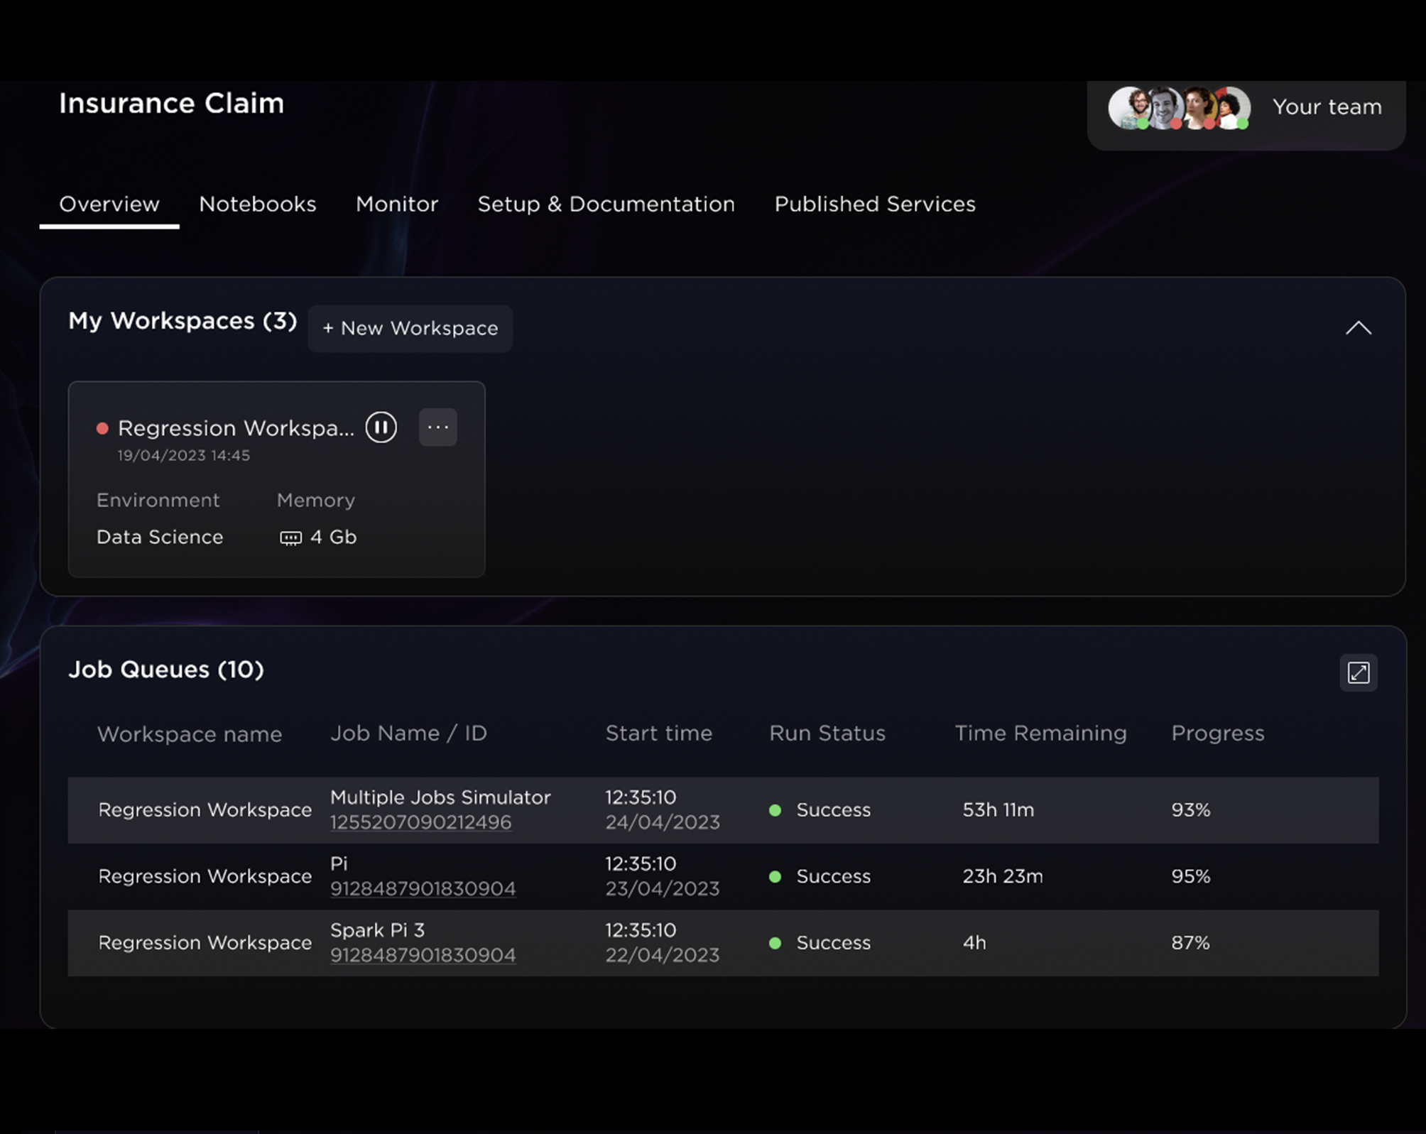
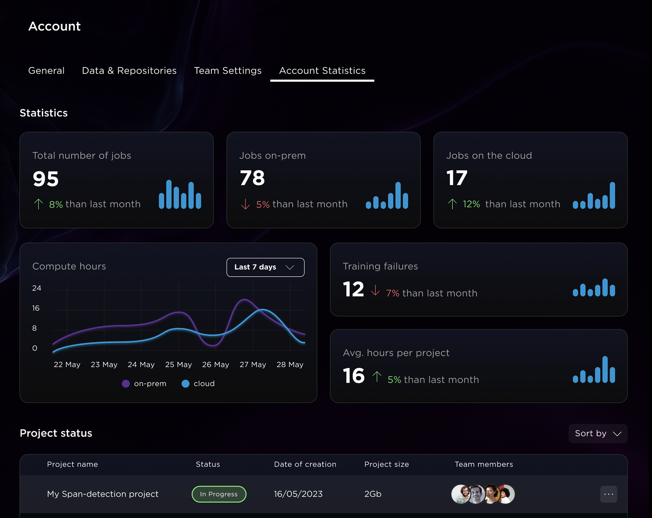
Z by HP AI studio
Connect
Collaborate
Compute
Private / HP Confidential

