Slide 1

Harnessing the Value of GenAI
Harnessing the Value of GenAI: Overcoming Challenges with Dynamic Data
Harnessing the Value of GenAI
Overcoming Challenges with Dynamic Data
Terry Dorsey
Sr. Data Architect and Evangelist for NA

Slide 2
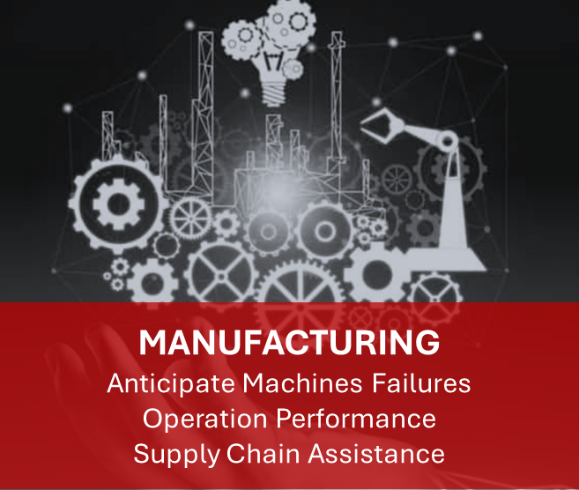


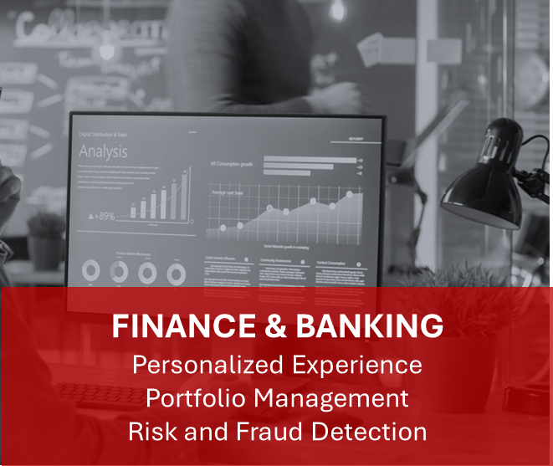
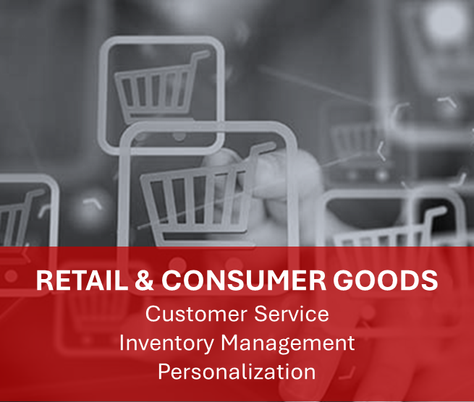
What do business users want to do?
General
Adhoc Analysis
Exploration
Generative BI

Slide 3


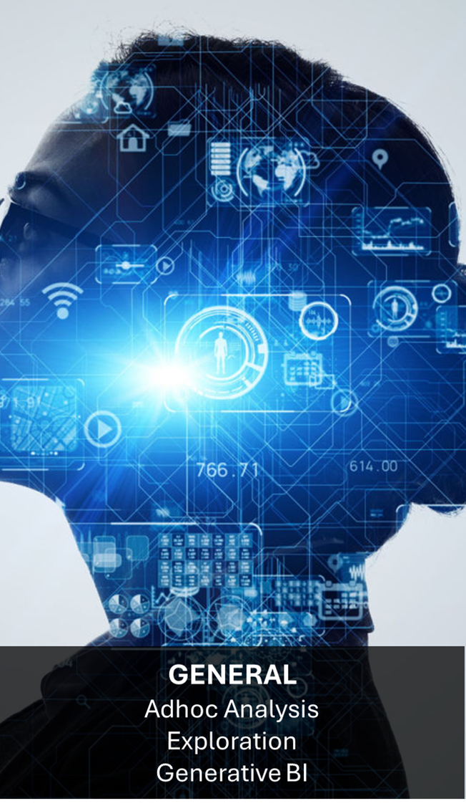

The Need for Real-Time Data
Better Decisions
Up to Date Responses
Better Accuracy
How can we leverage real-time data with GenAI?

Slide 4


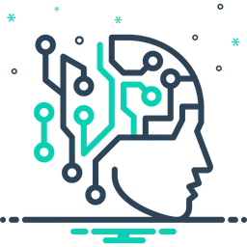
The RAG Pattern
1
Send Request
Send Response
2
Application or Agent
AI Model (LLM)

Slide 5

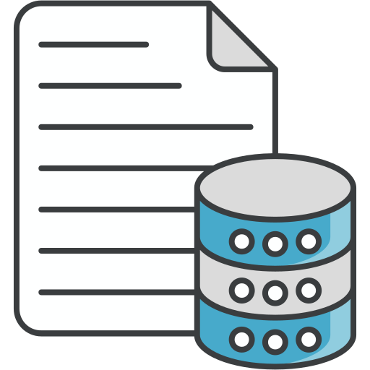
The RAG Pattern
…
2
Send Request
3
Send Augmented Request
4
AI Model (LLM)
Application or Agent
Send Response
1
Retrieve Data
Organizational Data

Slide 6

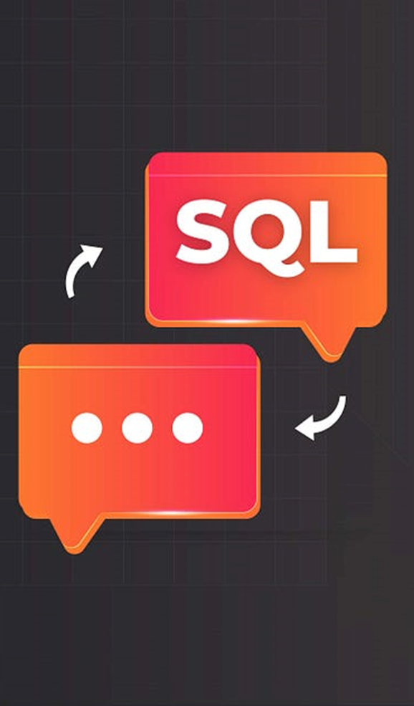

The R in RAG
Semantic Search
Relationship Search
Vector Embeddings
Indexing
Natural Language
Query
Vector Embeddings
Graph Traversal

Slide 7
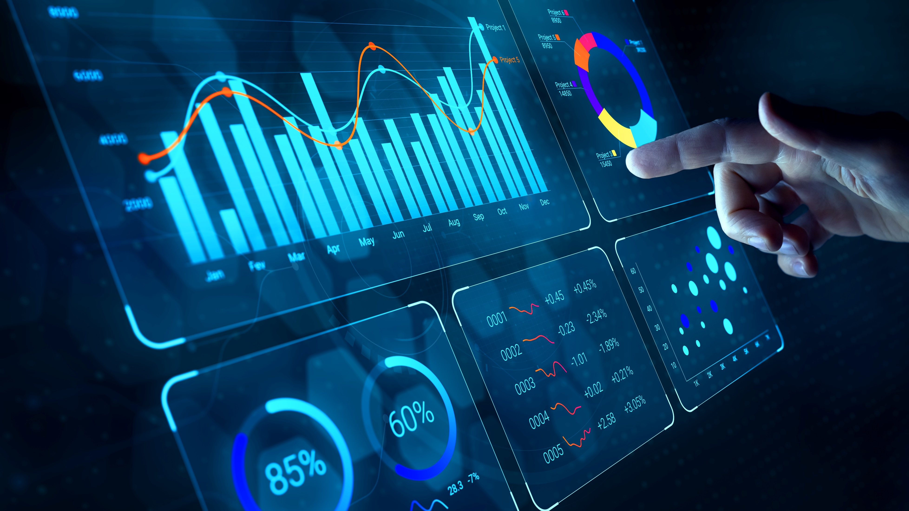

#4
among languages
SQL is popular
A lot of people know it
BI tools leverage it
LLMs are good at it
SQL Generation is a powerful use of GenAI!
https://www.hackerrank.com/blog/most-popular-languages-2024/

Slide 8
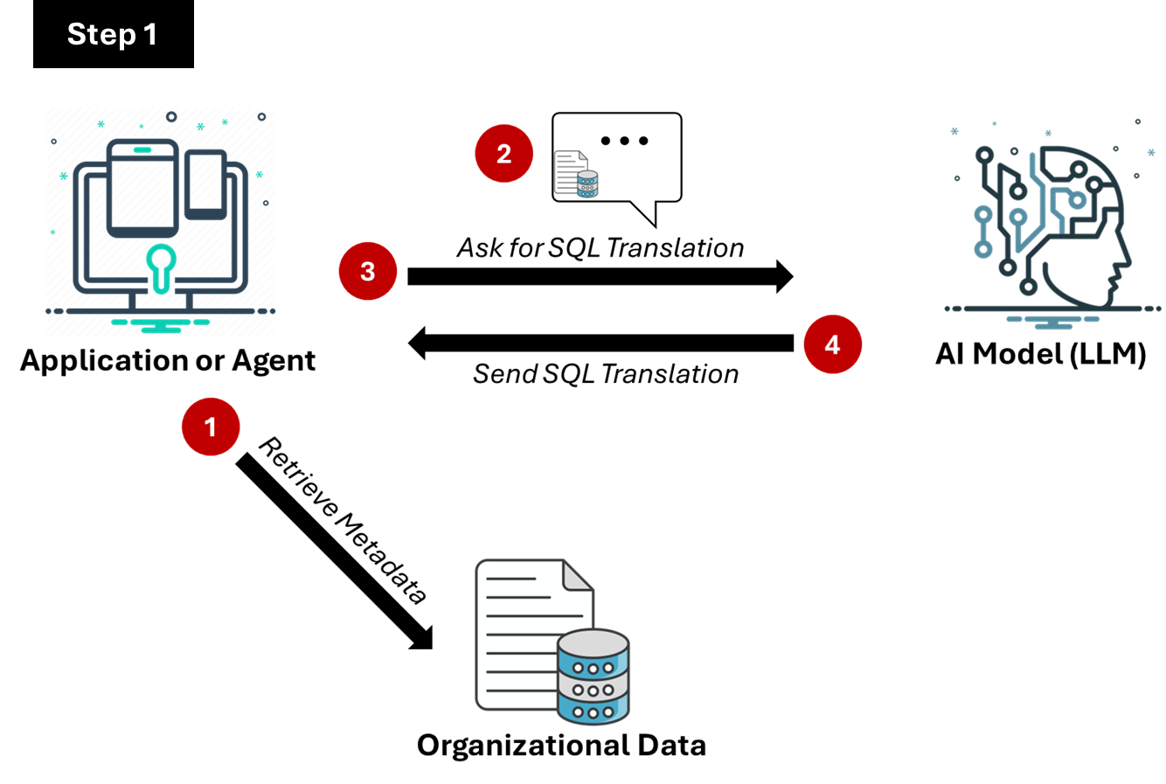
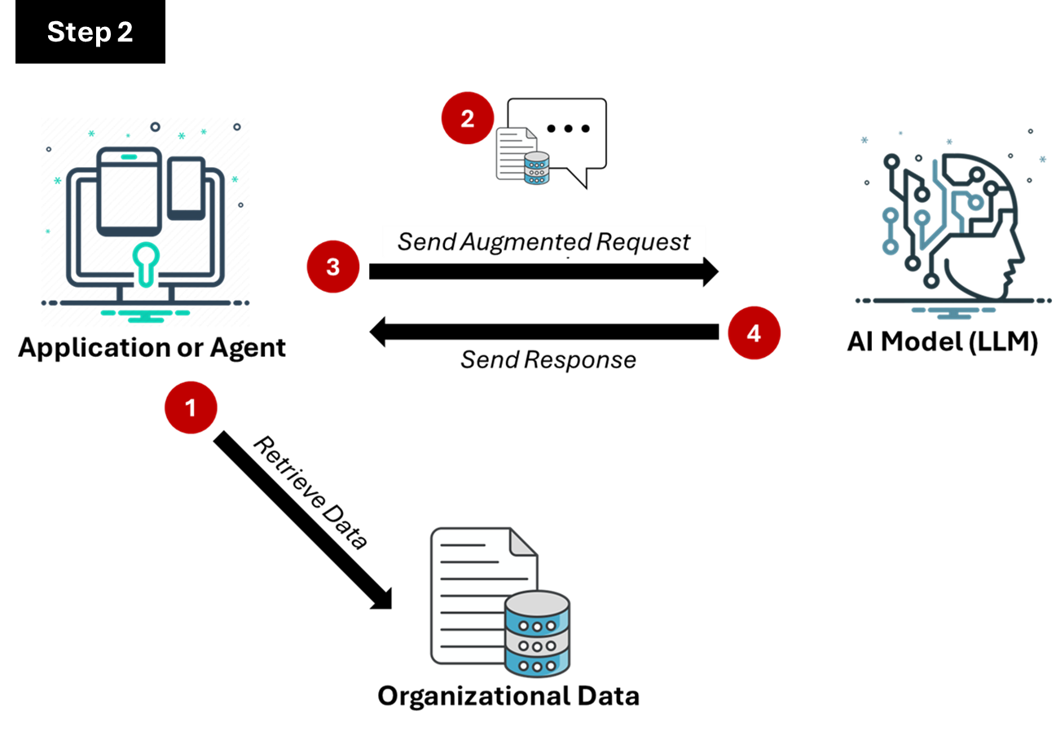
The QueryRAG Pattern

Slide 9
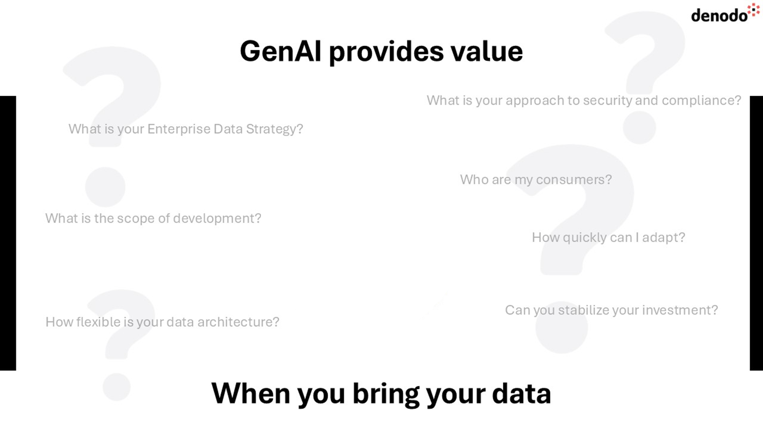


Slide 10
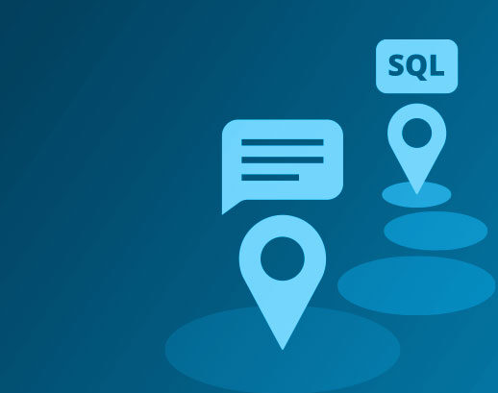
QueryRag and a Logical Data Fabric
Leverages strength of LLMs
Implements RAG approach
Simplifies Development
Consistent Interface
Dynamic Metadata and Data
Data from Anywhere
Secure Execution
Stabilizes investment
Foundation for GenBI

Slide 11
GenAI provides value with your data
3
Organizational Data
Dynamic
Distributed
Complex
Varied
1
Application or Agent
Stable Framework
Consistent Interface to Data
2
AI Model (LLM)
Many Available
Alignment to Use Case
Available Frameworks

Slide 12
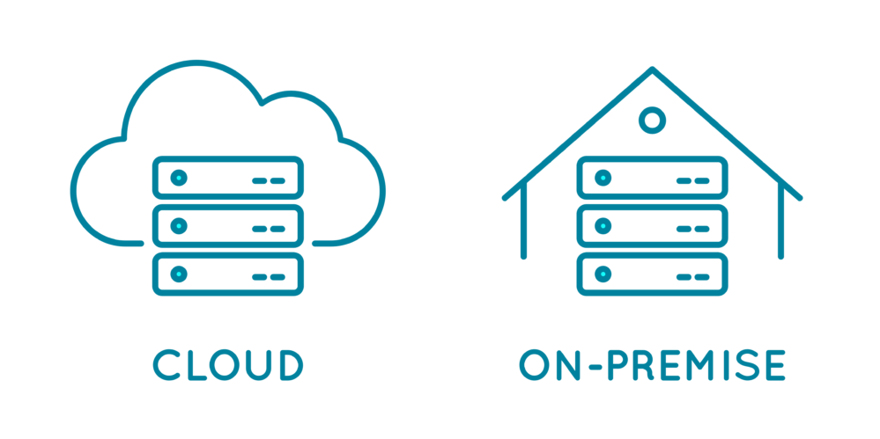
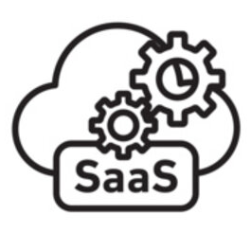
GenAI and the Complex Data Landscapes of Today
3
Organizational Data
Dynamic
Distributed
Complex
Varied
1
Application or Agent
Stable Framework
Consistent Interface to Data
Questions:
Where do I manage semantics?
How to ensure security and compliance?
How do I adapt to changes?
How can I maintain stability?
How will it scale?
2
AI Model (LLM)
Many Available
Alignment to Use Case
Available Frameworks

Slide 13






AI For All through a Data Catalog
Data Catalog as the Application
Stable Framework
Consistent Interface to Data
Logical Data Fabric
Catalog
1
2
I have a question about customers
Can you give me the SQL I need to run?,
3
What you get
Ready-built GenAI Application
Access data from anywhere
Simplified Data Security & Governance
Simplified Schema
A Powerful Query Optimizer
Robust Unified Semantic layer
Insulation from Changes
I’ll handle the rest!
Account
Customer
AI Model (LLM)
Many Available
Alignment to Use Case
Available Frameworks
Organizational Data
Dynamic
Distributed
Complex
Varied

Slide 14

GenAI and a Simplified Development Framework
Application or Agent
Stable Framework
Consistent Interface to Data
Organizational Data
Dynamic
Distributed
Complex
Varied
Logical Data Fabric
2
1
Tell me about an employee
I have a question about customers
Please run this SQL
Account
Customer
3
What you get
Simplified Application Framework
Consistent access to Metadata
Secure Interface to Data
Simplified Interoperability
A Unified SQL Access Engine
Optimized Query Engine
An AI SDK
AI Model (LLM)
Many Available
Alignment to Use Case
Available Frameworks

Slide 15
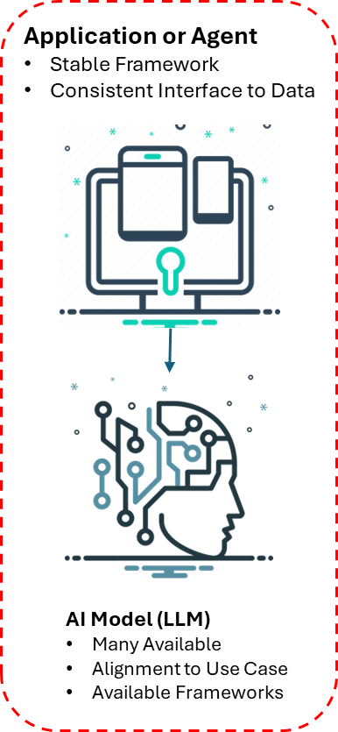
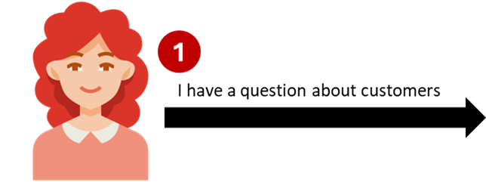
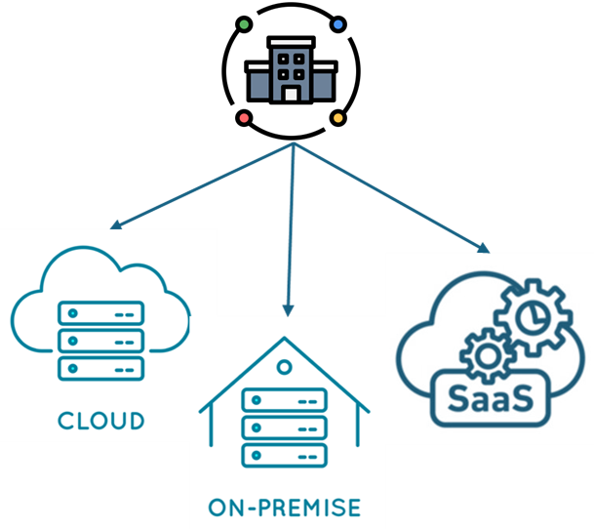
Extends to Highly Distributed Landscapes
Logical Data Fabric
2
Tell me about a customer
Please run this SQL
Account
Customer
3
East
West
Supports Distributed Organizations
Multi-Location including Global
Insulation from Volatility
Enables Independence and Compliance
Aligns to your organizational governance

Slide 16
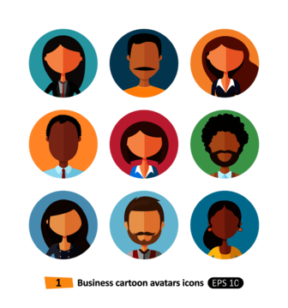



Let the experts do what they do best
Domain experts
We can restrict and secure data and control organizational terms used for generative AI
Data engineering
We can work with organizational views and services. It is so much easier and faster to create data products for everyone without having to worry about changes to our landscape.
AI development
We do not need to add data management to our task. We can build frameworks that leverage the enterprise safely and effectively
Security
We can audit access to information used for AI and other solutions in one place. It all makes sense too, because it is in the language of our business!
Data management
We can manage data effectively and efficiently. I can provide the secure
and organization-friendly foundations
for everyone.
Ever-changing data landscape

Slide 17

GenAI is a Game Changer
“…first technology launched at scale with known flaws”, but “…holds the power to transform a generation”
CIO Magazine: Generative AI: The CIO’s Apollo Moment
Advancements
Better LLMs
Interactivity with Data
Improved Accessibility
Embedded in Applications for Productivity
Faster Technology (i.e. storage, compute)
Expanded Uses and Techniques
Strategic Considerations
Adapt fast
Rethink Ways of Working
Democratization of Technology
Faster Learning Cycles
Create “Option Value”
Prepare to Scale

Slide 18

Key Takeaways
Generative AI is transformational
QueryRAG will enable you to realize significant potential of GenAI
A logical data architecture is the quickest and easiest way to get ‘AI ready’
With a logical data architecture, you can scale efficiently
Learn more about QueryRAG:
https://www.datamanagementblog.com/query-rag-a-new-way-to-ground-llms-with-facts-and-create-powerful-data-agents/

Slide 19
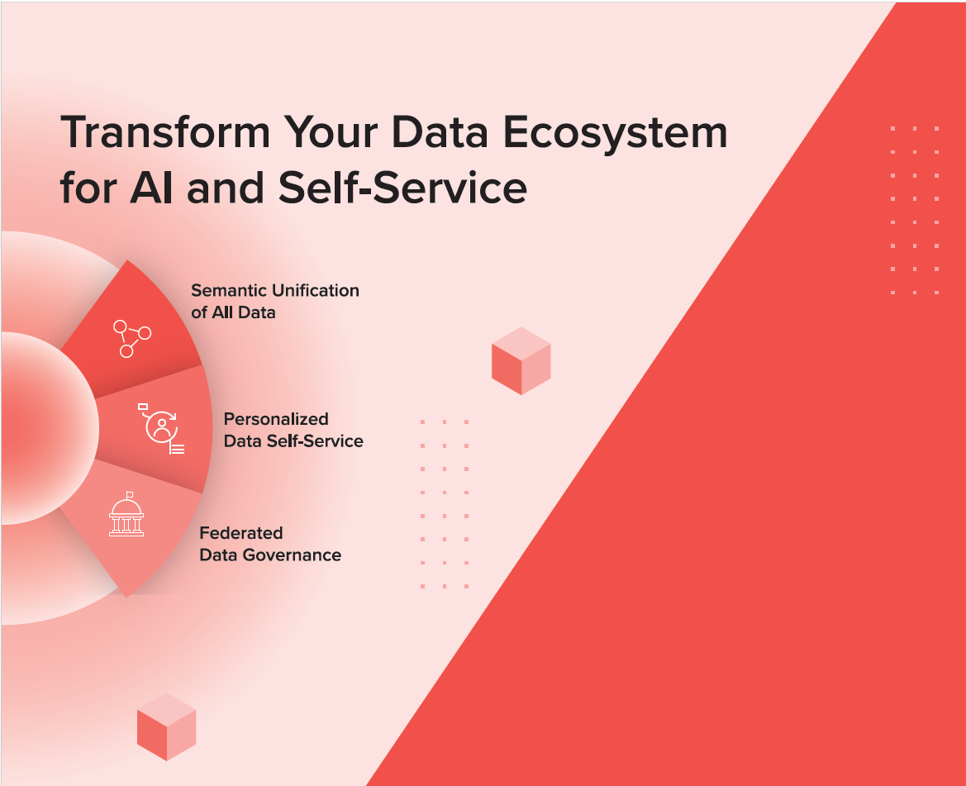

Learn More
Visit the Denodo Booth
or contact
Carlisle Gomes
cgomes@denodo.com

Slide 20
Questions

